Slide 1
PPI Network

Slide 2
Data
PPI file from Sandeep (iref14_human_UP_nodup_table.txt)
328 DEGs
Took any row that contained a DEG

Slide 3
Node size = Degree
DEG
DEG neighbour

Slide 4
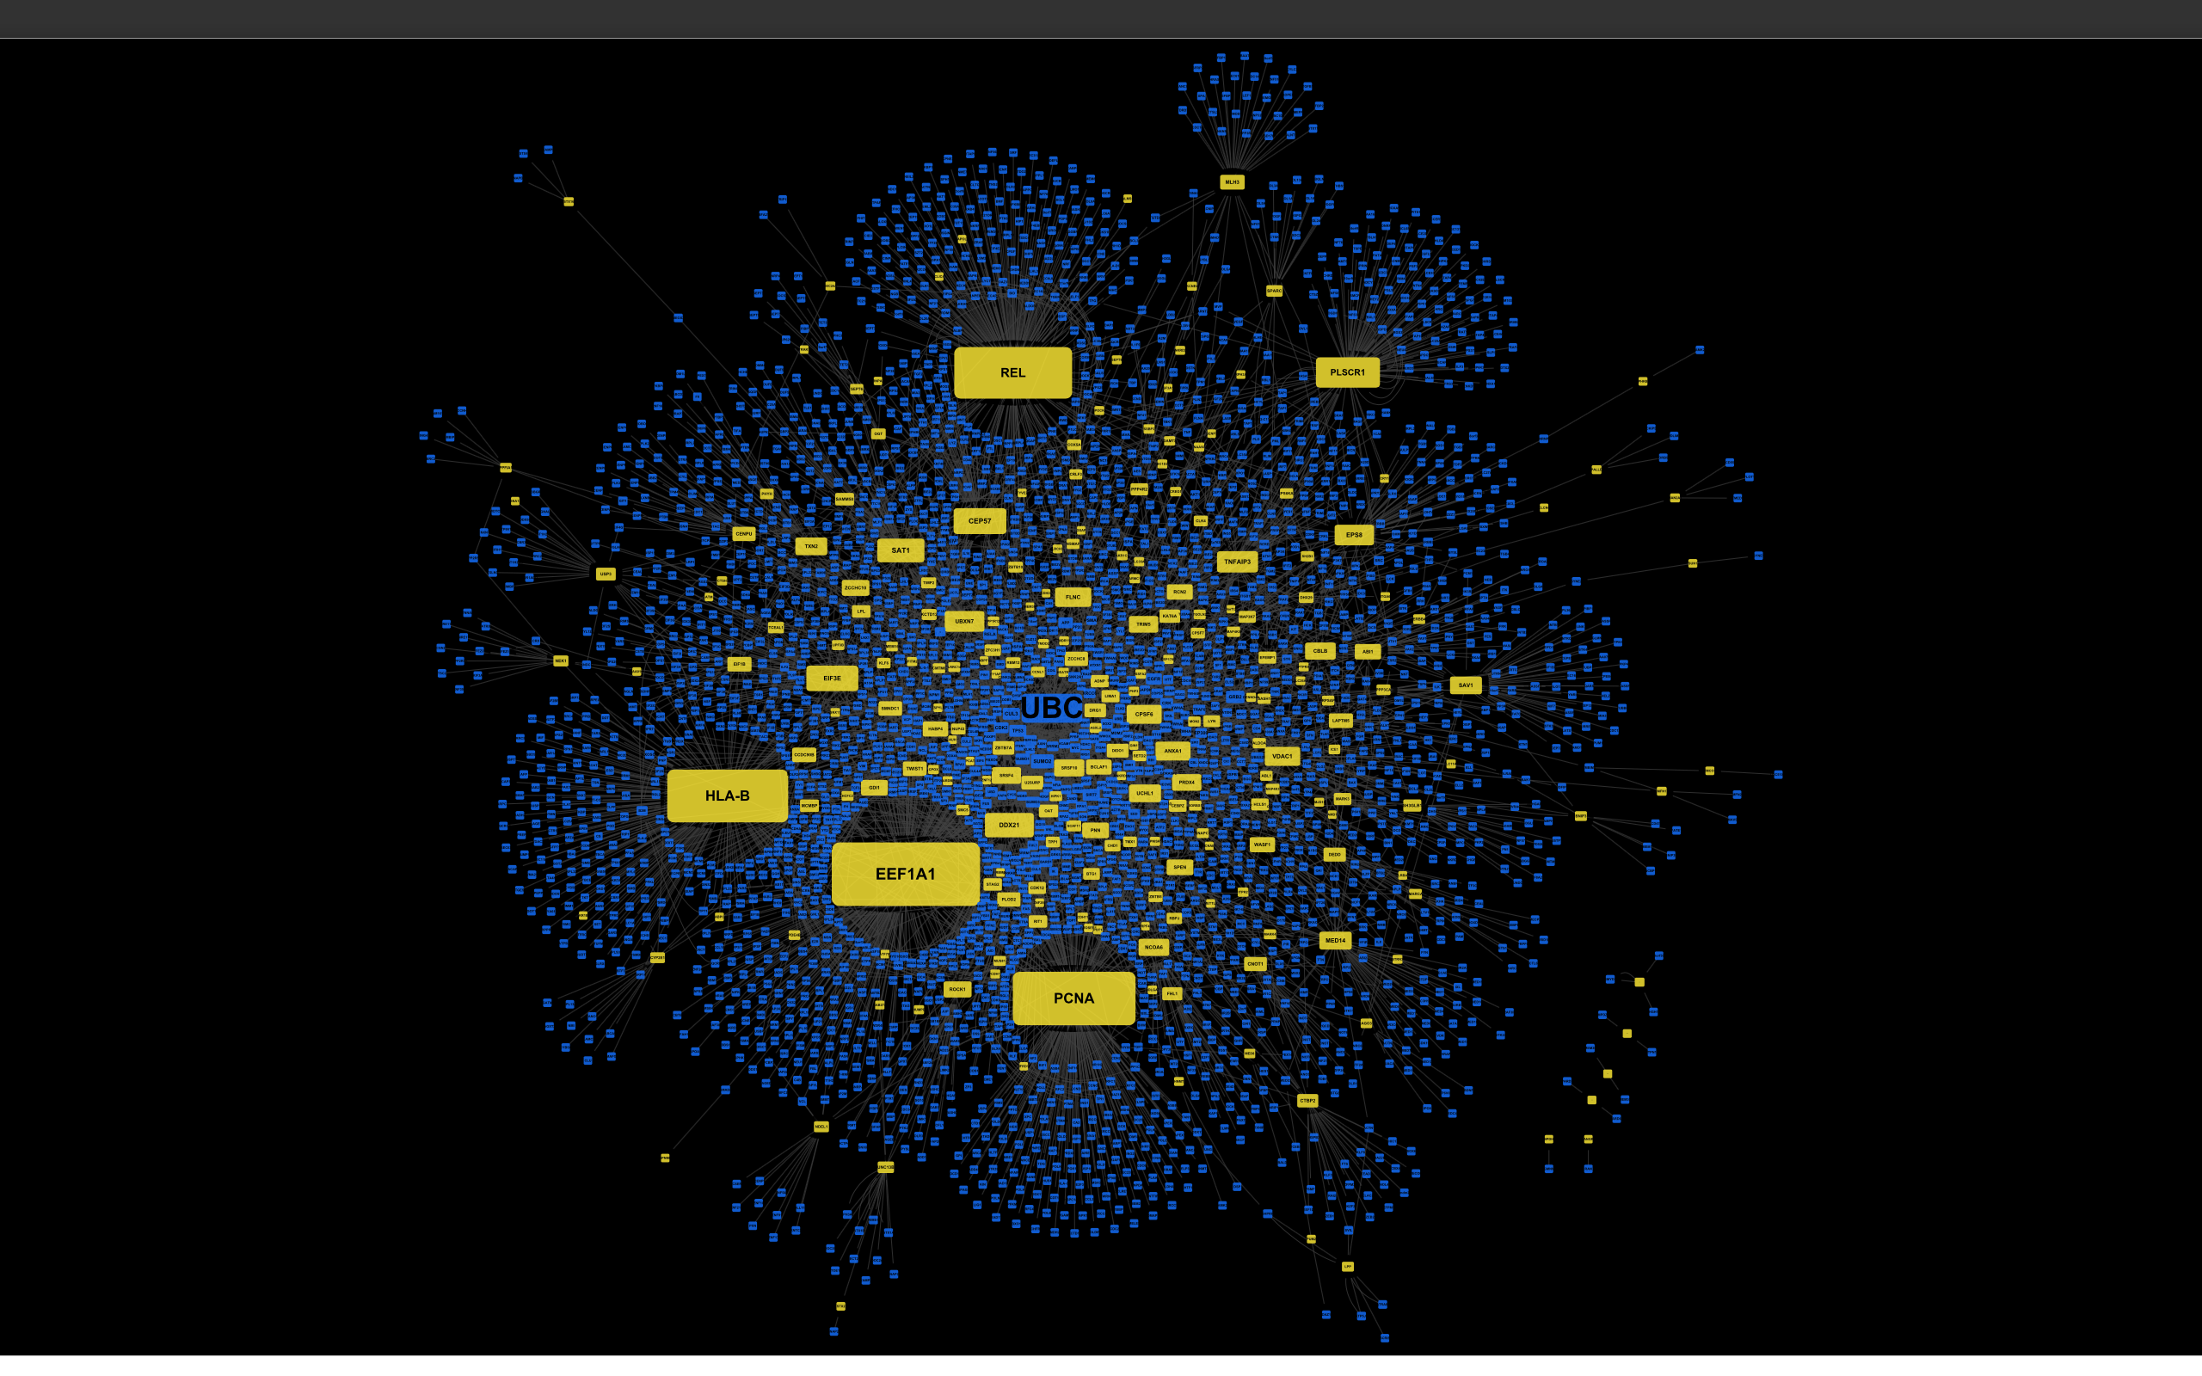
DEGs
First-degree binding proteins

Slide 5
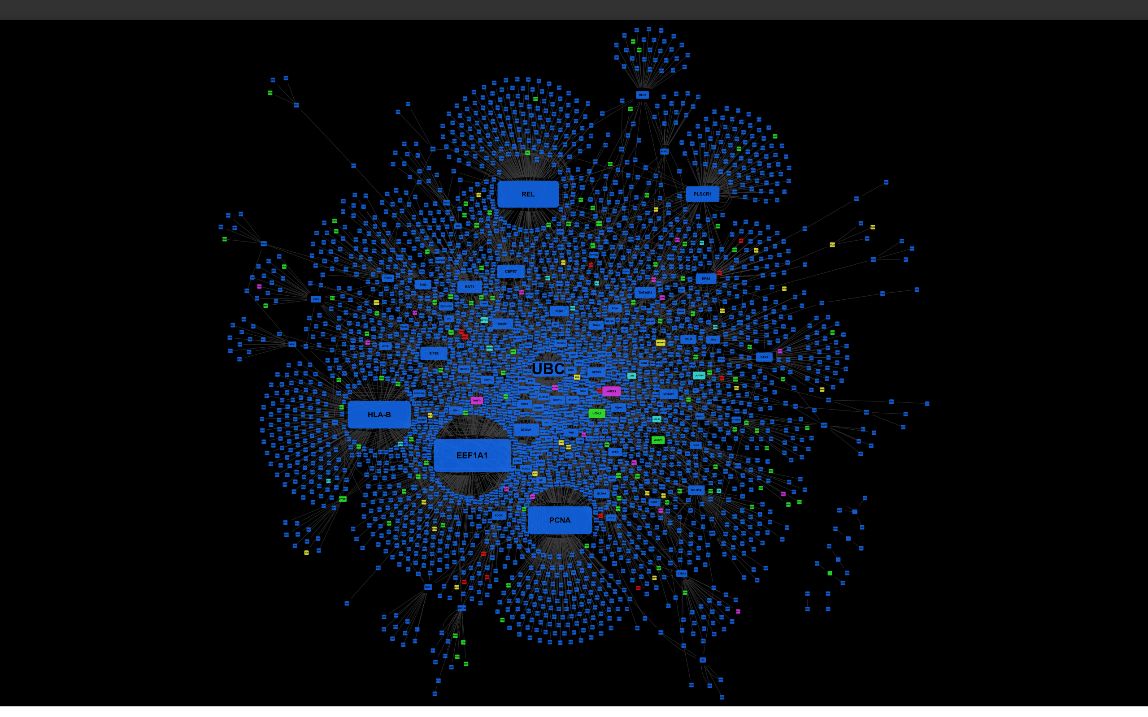
Astrocytes
Endothelial
Microglia
Neurons
Oligodendrocytes

Slide 6
New links (Sept 17)
http://amp.pharm.mssm.edu/Enrichr/enrich?dataset=2nphl

Slide 7
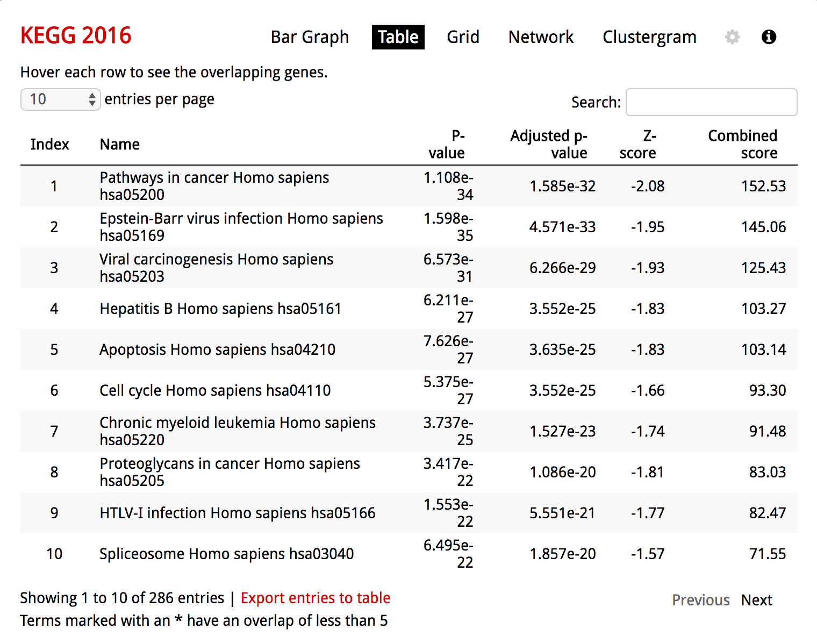
Functional Enrichment

Slide 8
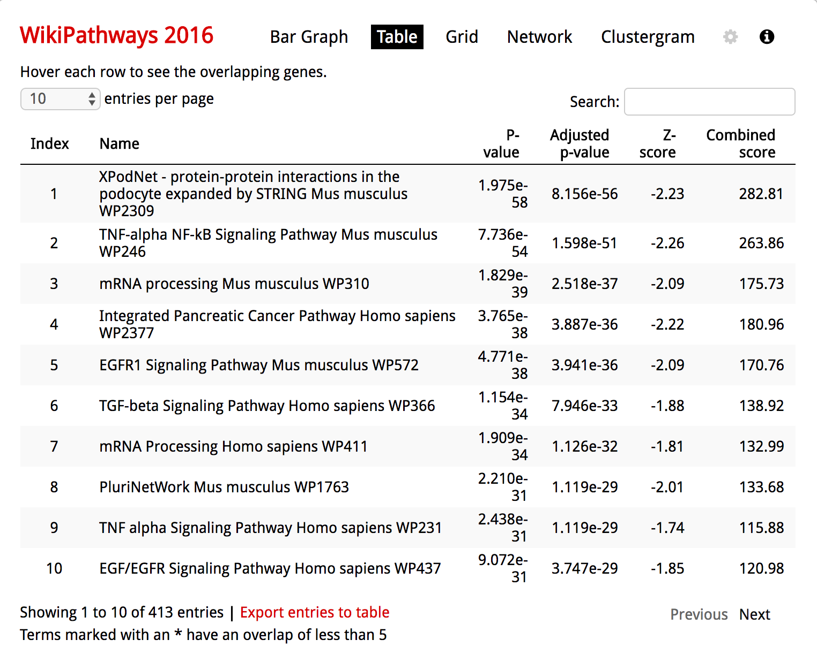

Slide 9
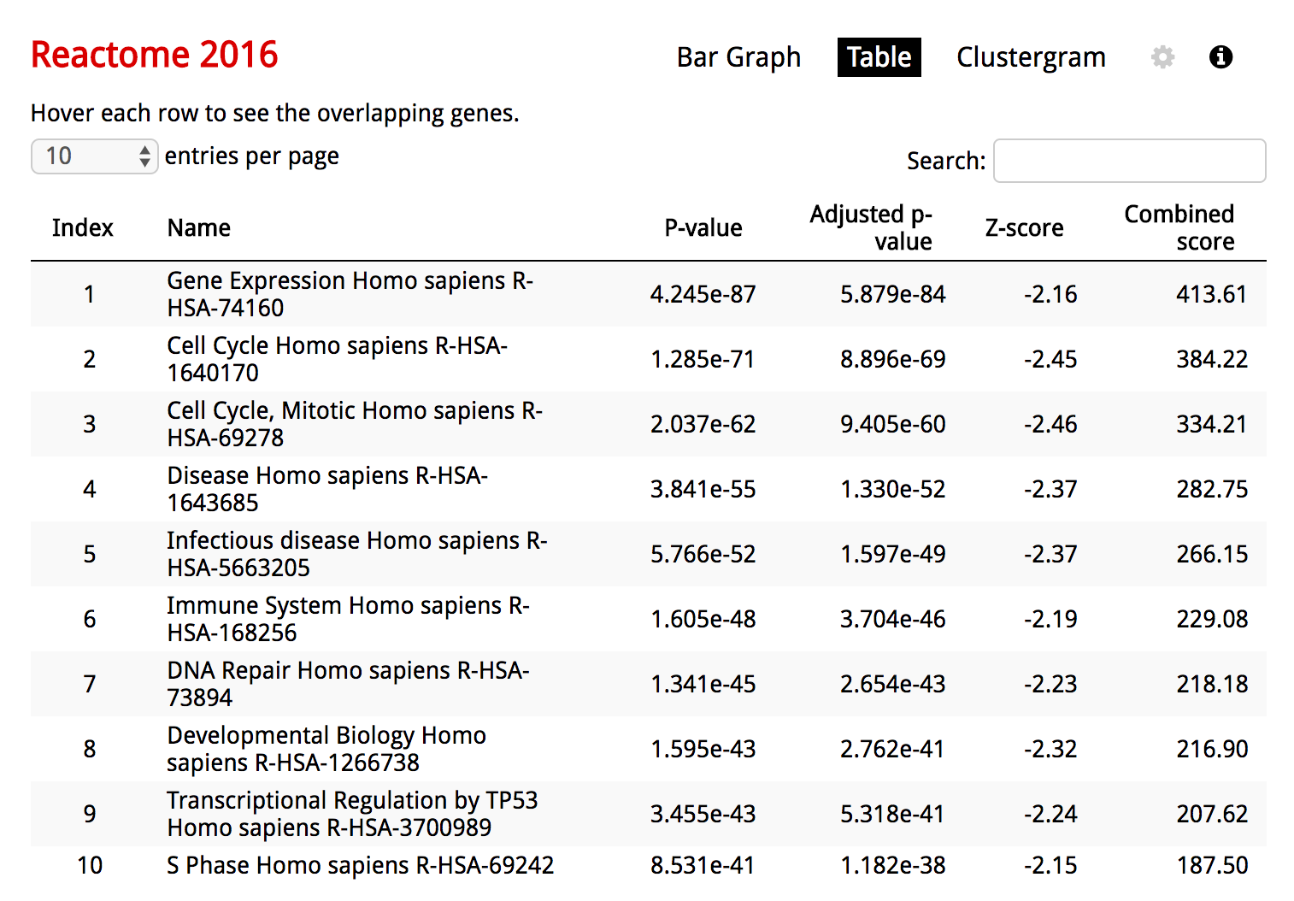
Functional Enrichment

Slide 10
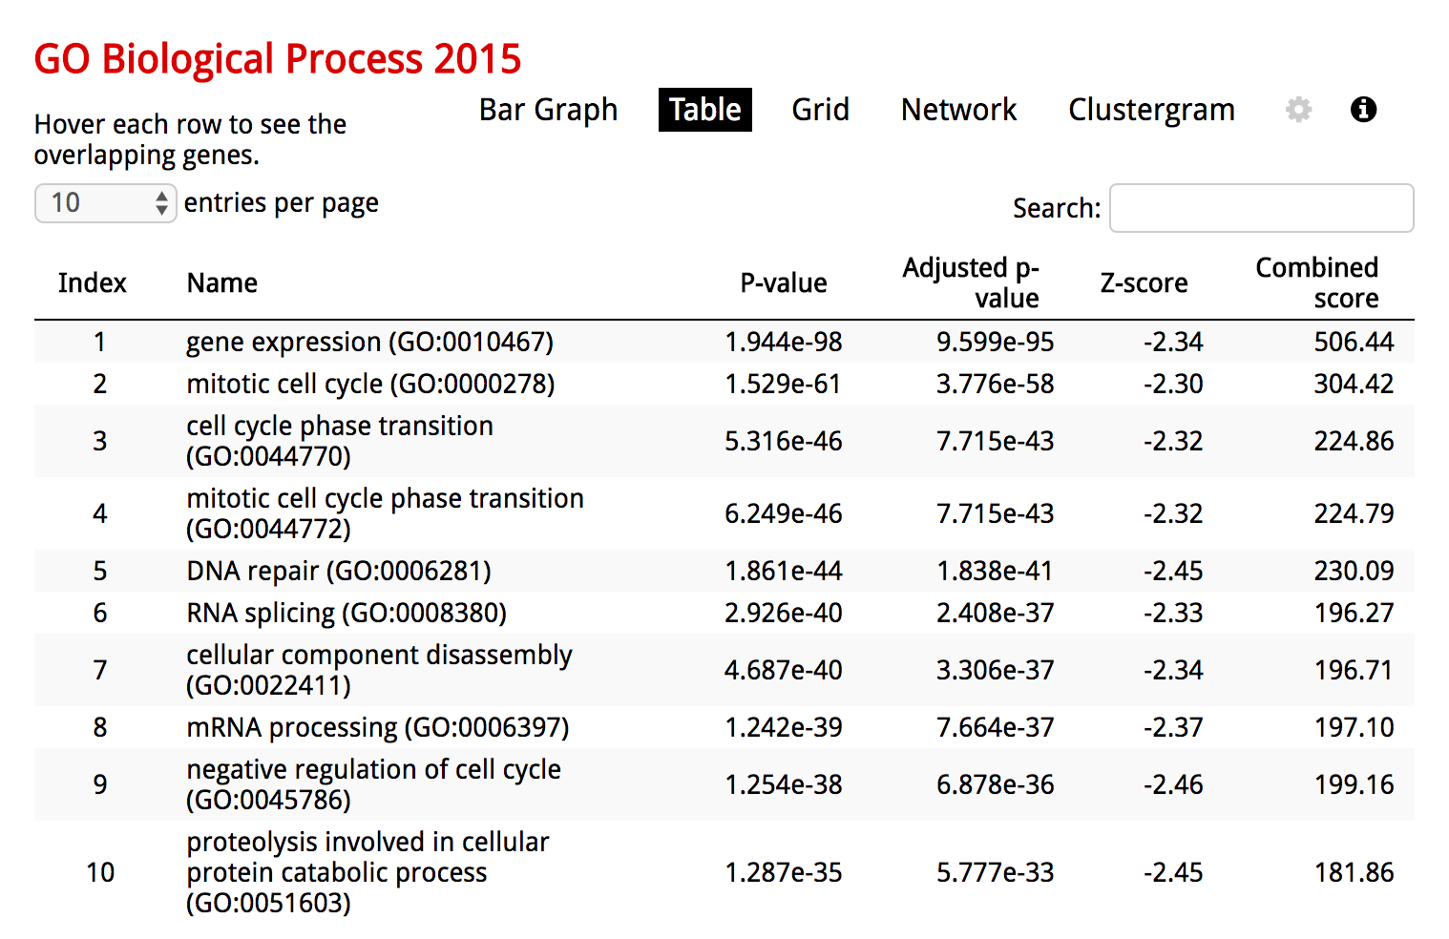

Slide 11
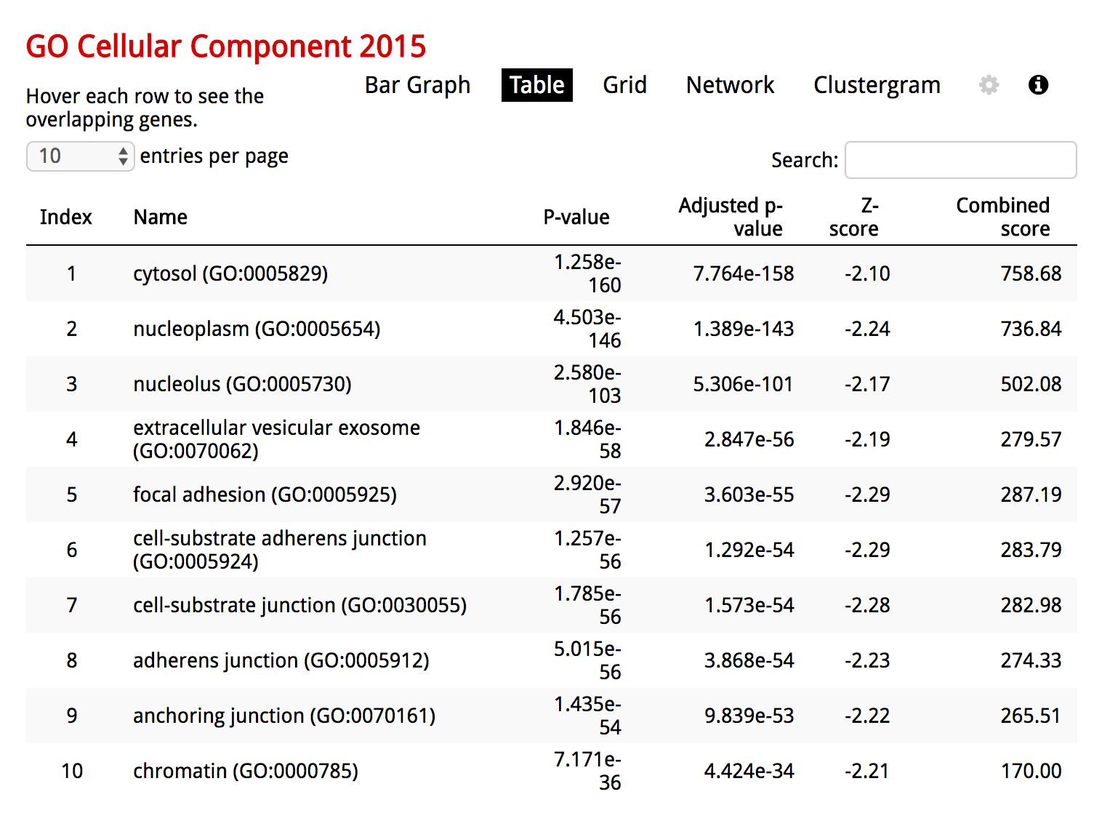

Slide 12
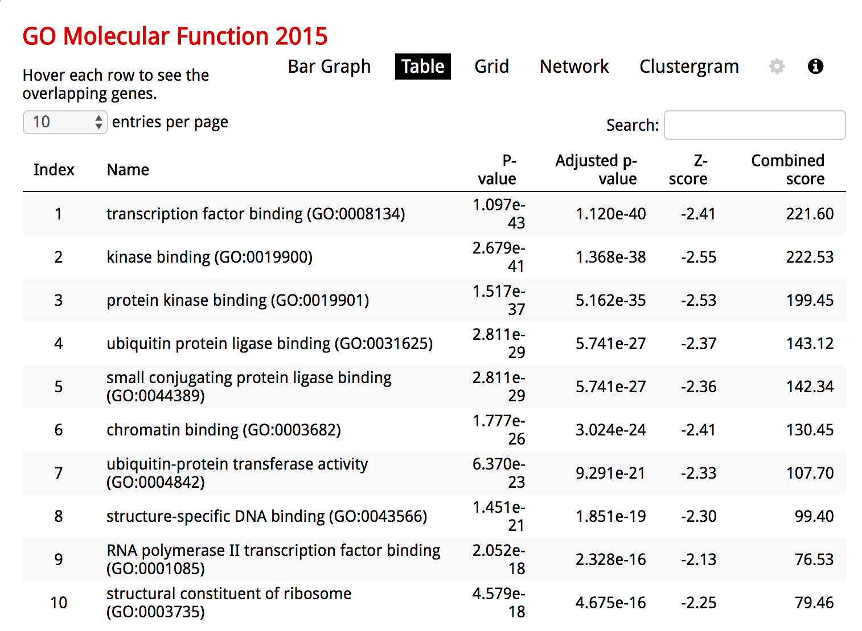

Slide 13
Mutation-specific PPIs
Took top 100 DEGs from C9orf72, VCP and GRN microarray results
Made PPI network of protein-coding genes
C9 → 91
VCP → 89
GRN → 100
Merged each network with the DEG PPI network
Look at overlap

Slide 14
C9orf72

Slide 15
VCP

Slide 16
GRN

Slide 17
C9orf72 PPI/DEG PPI overlap enrichment – Top 10
KEGG: pathways in cancer (7.1e-33), hepatitis B, MAPK signaling pathway, prostate cancer, Epstein-Barr virus infection, viral carcinogenesis, chronic myeloid leukemia, cell cycle, proteoglycans in cancer, HTLV-I infection (2e-19)
Wikipathways: Integrated pancreatic cancer pathway (7e-31), XPodNet – protein-protein interactions in the podocyte expanded by STRING, PluriNetWork Mus musculus, TGF-beta signaling pathway, TNF-alpha NG-kB signaling, MAPK signaling, EGFR1 signaling, cytoplasmic ribosomal proteins, androgen receptor signaling, MAPK signaling (5.5e-20)
Reactome: Gene expression (4.5e-43), Disease, cell cycle, immune system, nonsense mediated decay (NMD) enhanced by the exon junction complex (EJC), nonsense-mediated decay (NMD) infectious disease, cell cycle, mitotic, adaptive immune system, diseases of signal transduction (4.3e-26)
GOBP: Gene expression (3.7e-43), negative regulation of cell cycle, viral life cycle, mitotic cell cycle phase transition, nuclear-transcribed mRNA catabolic process, nonsense-mediated decay, cell cycle phase transition, nuclear transcribed mRNA catabolic process, mRNA catabolic process, RNA catabolic process, mitotic cell cycle(1.3e-24)
GOCC: Cytosol (9.7e-71), nucleoplasm, nucleolus, cell-substrate junction, focal adhesion, cell-substrate adherens junction, adherens junction, extracellular vesicular exosome, anchoring junction, chromatin (8.6e-19)
GOMF: Transcription factor binding (9.7e-71), ubiquitin protein ligase binding, small conjugating protein ligase binding, kinase binding, protein kinase binding, ubiquitin-protein transferase activity, RNA polymerase II regulatory region DNA binding, RNA polymerase II transcription factor binding, ligase activity, structural constituent of ribosome(4.9e-14)

Slide 18
VCP PPI/DEG PPI overlap enrichment – Top 10
KEGG: Epstein-Barr virus infection (5.8e-46), pathways in cancer, chronic myeloid leukemia, ErbB signaling pathway, viral carcinogenesis, focal adhesion, neurotrophin signaling pathway, prostate cancer, glioma, endocytosis (3.6e-22)
Wikipathways: XPodNet – protein-protein interactions in the podocyte expanded by STRING (1.7e-75), EGFR1 signaling pathway, EGF/EGFR signaling pathway, TNF-alpha NF-kB signaling pathway, PluriNetWork Mus musculus, TFG0beta signaling pathway, B cell receptor signaling pathway, IL-3 signaling pathway, cytoplasmic ribosomal proteins (HS), cytoplasmic ribosomal proteins(MM) (1.4e-29)
Reactome: Gene expression (3.7e-79), disease, immune system, infectious disease, cell cycle, adaptive immune system, developmental biology, signalling by NGF, innate immune system, diseases of signal transduction (1.3e-41)
GOBP: Gene expression (4.2e-89), modification-dependent protein catabolic process, modification-dependent macromolecule catabolic process, ubiquitin-dependent protein catabolic process, proteolysis involved in cellular protein catabolic process, nuclear-transcribed mRNA catabolic process, nonsense-mediated decay, RNA catabolic process, nuclear-transcribed mRNA catabolic process, protein localisation to organelle, mRNA catabolic process (2.5e-34)
GOCC: Cytosol (4e-156), nucleoplasm, nucleolus, extracellular vesicular exosome, nuclear chromosome part, focal adhesion cell-substrate junction, cell-substrate adherens junction, adherens junction, anchoring junction (6.8e-44)
GOMF: Kinase binding (3.4e-36), protein kinase binding, chromatin binding, ATP binding, ligase activity, transcription factor binding, ubiquitin-protein transferase activity, small conjugating protein ligase, ubiquitin protein ligase binding, transcription coactivator activity (1.6e-20)

Slide 19
GRN PPI/DEG PPI overlap enrichment – Top 10
KEGG: Pathways in cancer (7.1e-30), ErbB signaling pathway, apoptosis, viral carcinogenesis, thyroid hormone signaling pathway, hepatitis B, proteoglycans in cancer, neurotrophin signaling pathway, MAPK signaling pathway, Epstein-Barr virus infection (2.7e-20)
Wikipathways: XPodNet – protein-protein interactions in the podocyte expanded by STRING (4e-61), EGFR1 signaling pathway, EGF/EGFR signaling pathway, TGF-beta signaling pathway, MAPK signaling pathway, IL-6 signaling pathway, MAPK signaling pathway, PluriNetWork Mus musculus, androgen receptor signaling pathway, BDNF signaling pathway (4.7e-27)
Reactome: Developmental biology (8.4e-56), signaling by NGF, innate immune system, immune system, signal transduction, VEGFA-VEGFR2, signaling by VEGF, axon guidance, Fc epsilon receptor (FCERI) signaling, NGF signalling via TRKA from the plasma membrane (2.3e-32)
GOBP: Neurotrophin signaling pathway (2e-27), neurotrophin TRK receptor signaling pathway, apoptotic signaling pathway, gene expression, regulation of apoptotic signaling pathway, regulation of protein serine/threonine kinase activity, positive regulation of proteolysis, positive regulation of kinase activity, MAPK cascade, positive regulation of protein kinase activity (1.7e-18)
GOCC: Nucleoplasm (2e-65), cytosol, nucleolus, adherens junction, anchoring junction, nuclear chromosome part, focal adhesion, cell-substrate adherens junction, cell-substrate junction, mediator complex (2.5e-19)
GOMF: Kinase binding (1.4e-31), protein kinase binding, transcription factor binding, chromatin binding, transcription coactivator activity, ubiquitin protein ligase binding, small conjugating protein ligase binding, transcription regulator region sequence-specific DNA binding, RNA polymerase II transcription factor activity, RNA polymerase II transcription cofactor activity (5e-14)

Slide 20
Lots of processes are shared
Which are unique to each gene?
Took genes specific to one mutation and then conducted functional enrichment
C9 → 434
VCP → 1636
GRN → 596

Slide 21
C9-specific genes only - Top 10
KEGG: MAPK signaling pathway (0.005), staphylococcus aureus infection, regulation of actin cytoskeleton, phagosome, HTLV-I infection, antigen processing and presentation, proteoglycans in cancer, longevity regulating pathway – multiple species, TGF-beta signaling pathway, rheumatoid arthritis (0.02)
Wikipathways: Circadian rhythm genes (0.03), integrated pancreatic cancer pathway, regulation of cytoskeleton (0.04)
Reactome: Adaptive immune system (0.0003), budding and maturation of HIV virion, endosomal sorting complex required for transport (ESCRT), energy dependent regulation of mTOR by LKB1-AMPK, MHC class II antigen presentation, mTOR signalling, PKB-mediated events, immune system, non-integrin membrane-ECM interactions, molecules associated with elastic fibres (0.003)
GOBP: negative regulation of cellular component organisation (0.0002), regulation of cellular response to stress, negative regulation of organelle organization, regulation of cell division, negative regulation of cell cycle, regulation of cellular protein catabolic process, regulation of proteasomal protein catabolic process, regulation of mitosis, negative regulation of proteolysis (0.003)
GOCC: Cytosol (3e-5), vacuole, lytic vacuole, lysosome, MHC class II protein complex, neuronal cell body, ER to Golgi transport vesicle membrane, cell body, nucleoplasm, ESCRT complex (0.005)
GOMF: Protein serine-threonine kinase activity (0.01), protein serine/threonine kinase activator activity, small conjugating protein binding, transcription factor binding, ubiquitin binding, protein N-terminus binding, RNA polymerase II core promoter proximal region sequence-specific DNA binding transcription factor activity, fibroblast growth factor binding, ubiquitin-protein transferase activity, protein C-terminus binding (0.047)

Slide 22
VCP-specific genes only - Top 10
KEGG: Epstein-Barr virus infection (2.1e-10), spliceosome, Jak-STAT signaling pathway, endocytosis, neurotrophin signaling pathway, proteasome, B cell receptor signaling pathway, cute myeloid leukemia, toxoplasmosis, herpes simplex infection (7e-5)
Wikipathways: XPodNet – protein-protein interactions in the podocyte expanded by STRING (3e-18), EGFR1 signaling pathway, TNF-alpha NF-kB signaling pathway, PodNet: protein –protein interactions in the podocyte, insulin signaling, EFG/EGFR signaling, mRNA processing, insulin signaling, proteasome degradation (HS), proteasome degradation (MM) (1e-5)
Reactome: Gene expression (8.2e-23), immune system, infectious disease, disease, cytokine signaling, adaptive immune system, HIV infection, signaling by EGFR, host interactions of HIV factors, antigen processing: ubiquitination & proteasome degradation (4.7e-11)
GOBP: gene expression (5.3e-23), modification-dependent protein catabolic process, ubiquitin-dependent protein catabolic process, modification-dependent macromolecule catabolic process, chromatin modification, proteolysis involved in cellular protein catabolic process, histone acetylation, peptidyl-lysine acetylation, internal protein amino acid acetylation, spliceosomal snRNP assembly (3.4e-9)
GOCC: Cytosol (6e-54), nucleoplasm, nucleolus, extracellular vesicular exosome, nuclear chromosome part, focal adhesion, cell-substrate junction, cell-substrate adherens junction, adherens junction, anchoring junction (6.5e-10)
GOMF: ATP binding (2e-16), ligase activity, chromatin binding, zinc ion binding, ubiquitin-protein transferase activity, kinase binding, transmembrane receptor protein kinase activity, transcription receptor protein kinase activity, transcription corepressor activity, protein kinase binding, protein tyrosine kinase activity (7.8e-7)

Slide 23
GRN-specific genes only - Top 10
KEGG: Glutamatergic synapse, (1.8e-8), cocaine addiction, cGMP-PKG signaling pathway, apoptosis, amphetamine addiction, long term potentiation, calcium signaling, circadian entrainment, TNF signaling pathway, oxytocin signaling pathway (6e-6)
Wikipathways: XPodNet – protein-protein interactions in the podocyte expanded by STRING (1.9e-7), Apoptosis modulation and signaling, hypothetical network for drug addiction (MM), BDNF signaling pathway, FAS pathway and stress induction of HSP regulation, hypothetical network for drug addiction (HS), calcium regulation in the cardiac cell (MM) calcium regulation in the cardiac cell (HS), MAPK signaling pathway, apoptosis (4.5e-5)
Reactome: Developmental biology (7.9e-12), transcriptional regulation of white adipocyte differentiation, PPARA actives gene expression, regulation of lipid metabolism by peroxisome proliferator-activated receptor alpha (PPARalpha), VEGFA-VEGFR2 pathway, CREB phosphorylation through the activation of CaMKII, signaling by VEGF, signaling by NGF, innate immune system, ras activation upon Ca2+ influx through NMDA receptor (9.9e-7)
GOBP: Regulation of synaptic transmission (4.9e-11), regulation of synaptic plasticity, toll-like receptor 4 signaling pathway, MyD88-independent toll-like receptor signaling pathway, transcription from RNA polymerase II promoter, regulation of protein serine/threonine kinase activity, TRIF-dependent toll-like receptor signaling pathway, synaptic transmission, toll-like receptor 3 signaling pathway, glutamate receptor signaling (5.7e-6)
GOCC: Synapse part (6.8e-9), nucleoplasm, receptor complex, mediator complex, cytosol, synaptic membrane, neuronal cell body, postsynaptic density, N-methyl D-aspartate selective glutamate receptor complex, post-synaptic membrane (1.7e-5)
GOMF: RNA polymerase II transcription factor binding transcription factor activity (2.8e-6), RNA polymerase II transcription cofactor activity, transcription factor coactivity, N-methyl-D-aspartate selective glutamate receptor activity, glutamate receptor activity, calcium ion transmembrane transporter activity, histone deacetylase binding, kinase binding, calcium channel activity, calmodulin binding (4.9e-5)

Slide 24
DEG PPI Network
Built a PPI network using IREF14
Took any row with a DEG
Result is a network with ~3500 nodes and ~7000 edges

Slide 25
DEG PPI network

Slide 26
Mutation 1
What is unique to each mutation?
What is common for each mutation?
Mutation 2
TDP-43 Pathology
Mutation 3

Slide 27
C9orf72
VCP
GRN

Slide 28
TDP-43 DEG PPI

Slide 29
TDP-43 DEG PPI

Slide 30
DEG PPI network

Slide 31
DEGs

Slide 32
C9orf72 overlap

Slide 33
GRN overlap

Slide 35
Immune response
Nervous system
Cell cycle
Cell process
Signalling
Metabolism
Endocrine
Genetic information processing

